Slide 1

CAPSTONE
Star Trek Captains - An NLP Inquiry
AUTHORIZED ACCESS ONLY
PLEASE REPORT BUGS TO DATA SCIENTIST ON DUTY

Slide 2

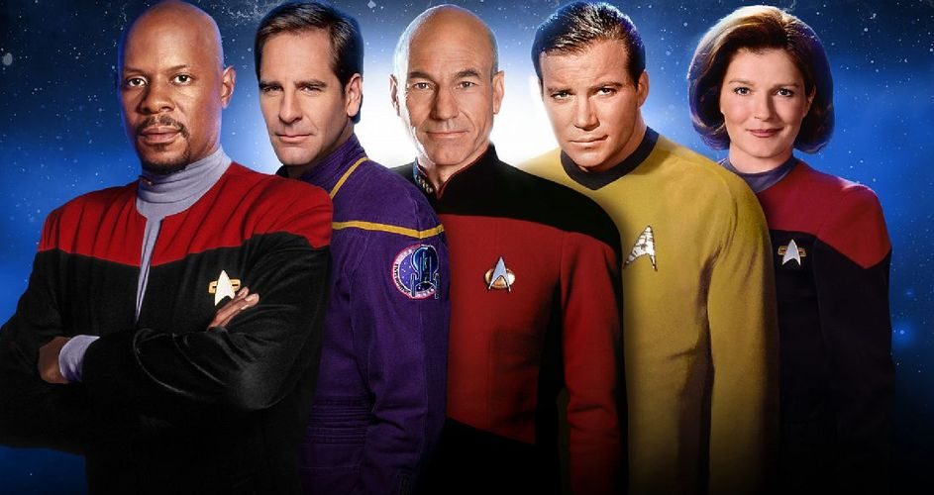
The Captains
Presentation Stardate 4763.44

Slide 3
Who said it?
There's no such thing as the unknown, only things temporarily hidden.
There's no such thing as the unknown, only things temporarily hidden.
There is coffee in that nebula.
Without evidence of intent, Number One, it will not be a simple matter.
Presentation Stardate 4763.44

Slide 4
Who said it?
There's no such thing as the unknown, only things temporarily hidden.
There's no such thing as the unknown, only things temporarily hidden. - James T. Kirk
There is coffee in that nebula.
- Kathryn Janeway
Without evidence of intent, Number One, it will not be a simple matter.
- Jean-Luc Picard
Presentation Stardate 4763.44

Slide 5
The Goal
Helping our computer to recognize which captain said a line it has not seen before!
In Data Science this is called creating and training a classification model.
Analysing how the model comes to its answer, and how often it is correct evaluating unseen lines:
The amount of correct answers divided by all answers is called
accuracy, this is our main metric for success!
Presentation Stardate 4763.44

Slide 6
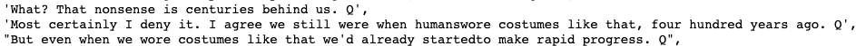
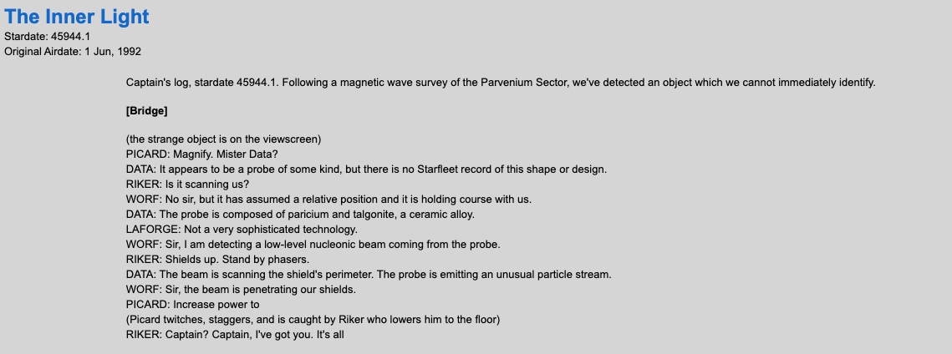
Data Acquisition
The issue with the Kaggle Dataset of lines per character:
The solution - collecting the data ourselves:
This is called scraping
Source: chakoteya.net
Presentation Stardate 4763.44

Slide 7
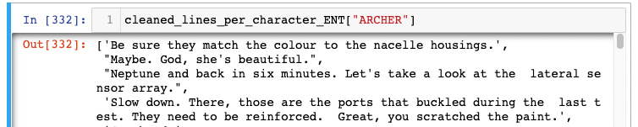
Data Cleaning
Fishing the character names and lines out of our html soup
Get rid of formatting characters, stage directions etc
Decide on minimum length of lines used (at least 5 words and at least 20 characters)
In the end we get a neat collection of lines for each of the captains:
Presentation Stardate 4763.44

Slide 8
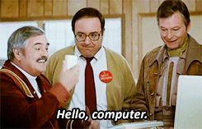
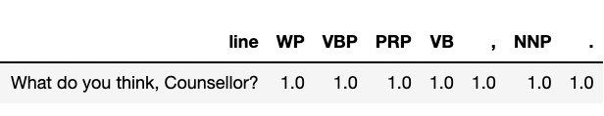
Feature Engineering
We humans can just read the line, but how can we communicate different aspects of a line of dialog to our computer?
NLP means just that: natural language processing
This is, where feature engineering starts.
Presentation Stardate 4763.44
Notes:
1339

Slide 9
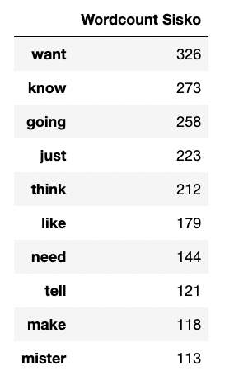
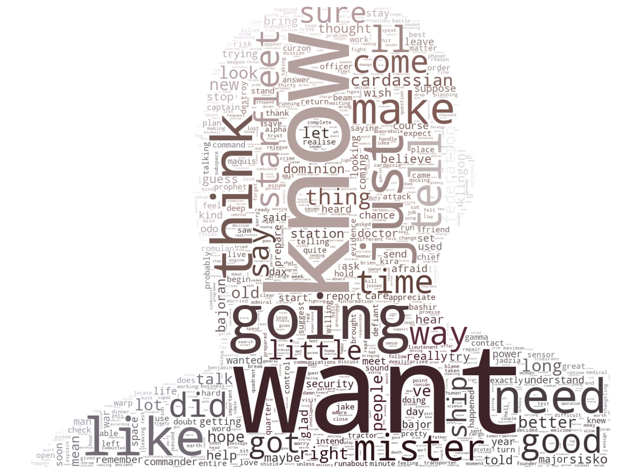
Counting words
Presentation Stardate 4763.44
Notes:
# verb, determiner, noun (singular), preposition, adverb

Slide 10
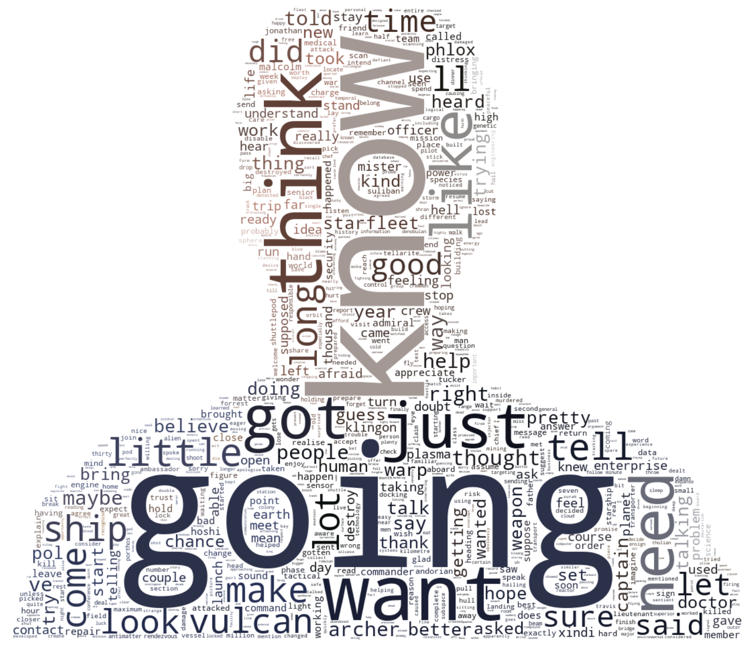
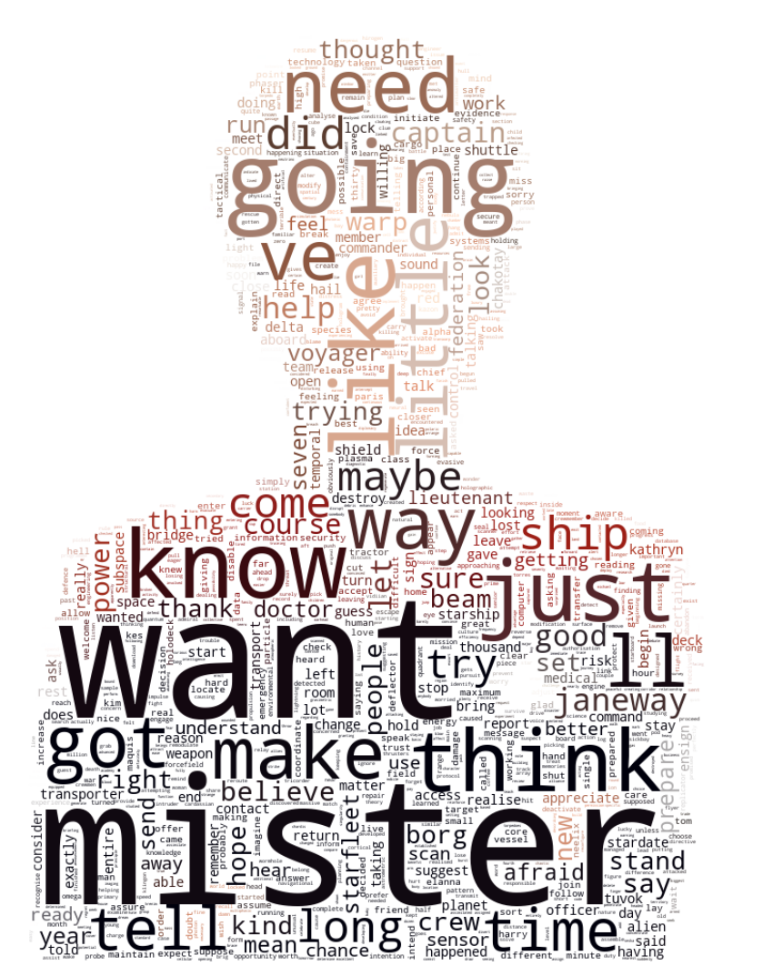
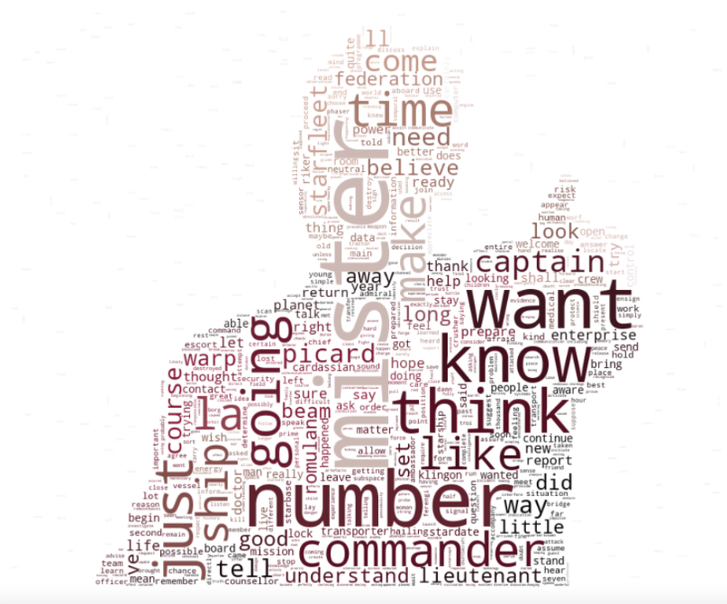
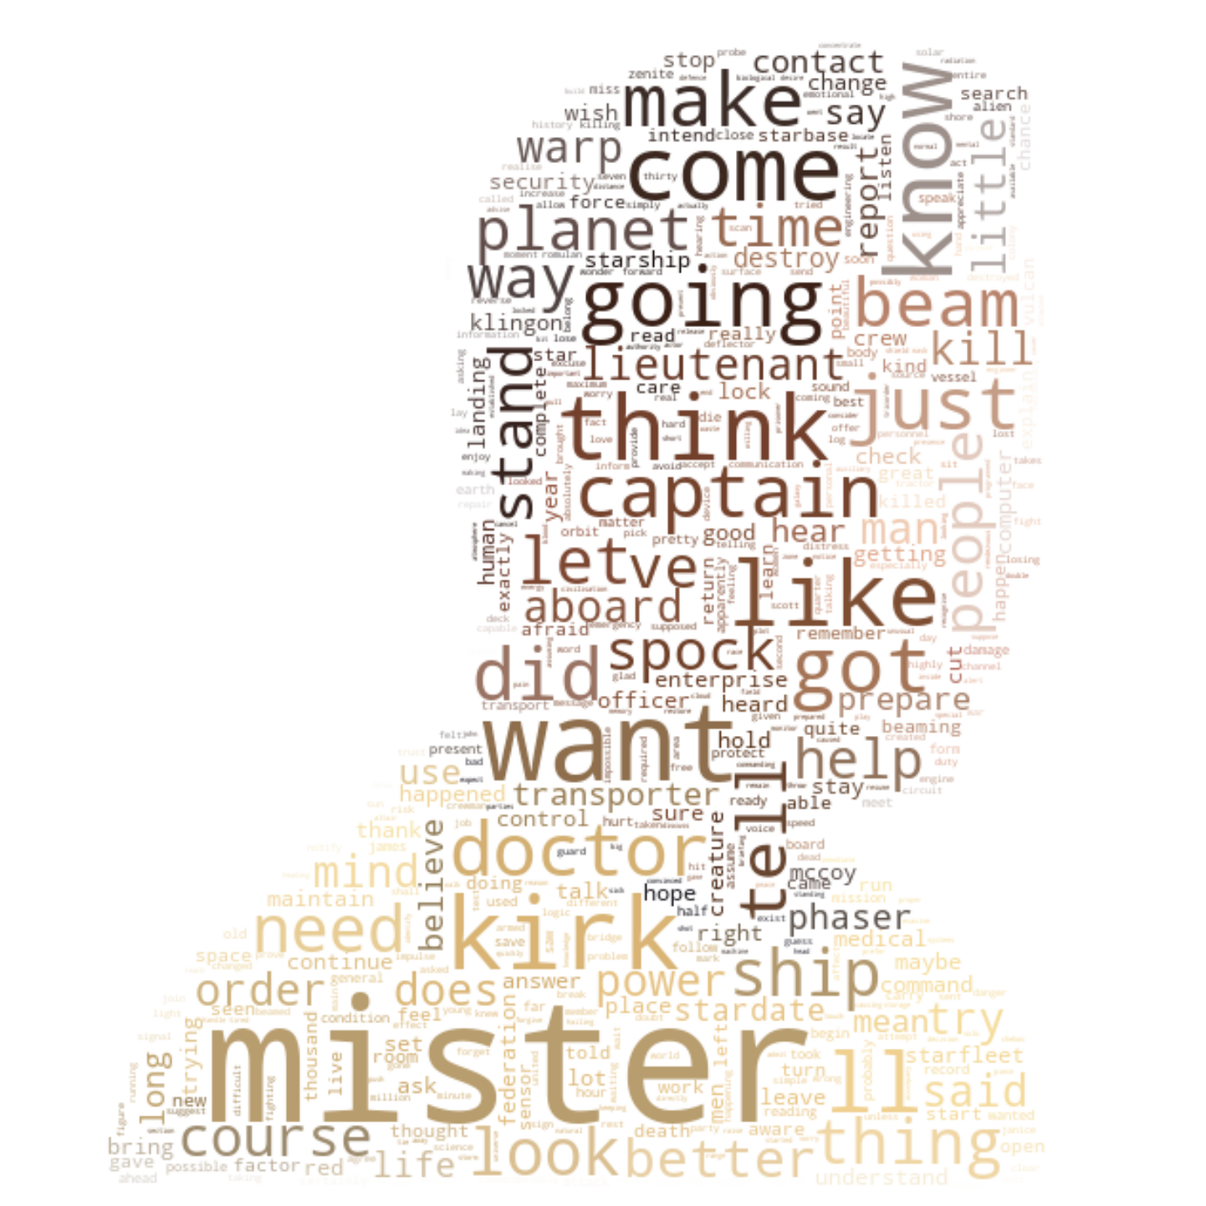
Counting words
Presentation Stardate 4763.44
Notes:
# verb, determiner, noun (singular), preposition, adverb

Slide 11
Counting words
Presentation Stardate 4763.44
Notes:
# verb, determiner, noun (singular), preposition, adverb

Slide 12
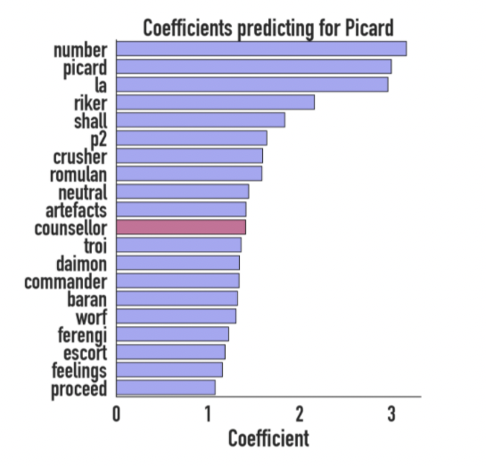
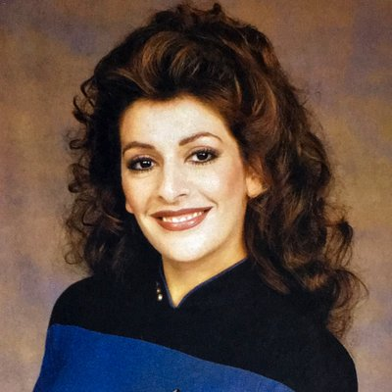
Finding useful words
Top 3 Coefficients:
Archer: archer, pol, phlox
Kirk: kirk, spock, mccoy
Sisko: sisko, dominion, odo
Janeway: janeway, kathryn, voyager
How good would different models be
only using the words like this?
Presentation Stardate 4763.44

Slide 13
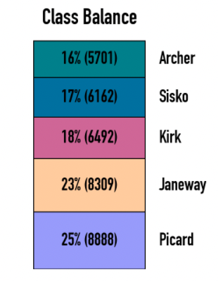
Success Metric
Accuracy = correct predictions / all predictions
What is a good accuracy score? It depends on what you are trying to do.
In this case: better than the baseline accuracy
better than a human?
Presentation Stardate 4763.44
Notes:
Total number of lines > 5 words and > 20 characters = 35552

Slide 14
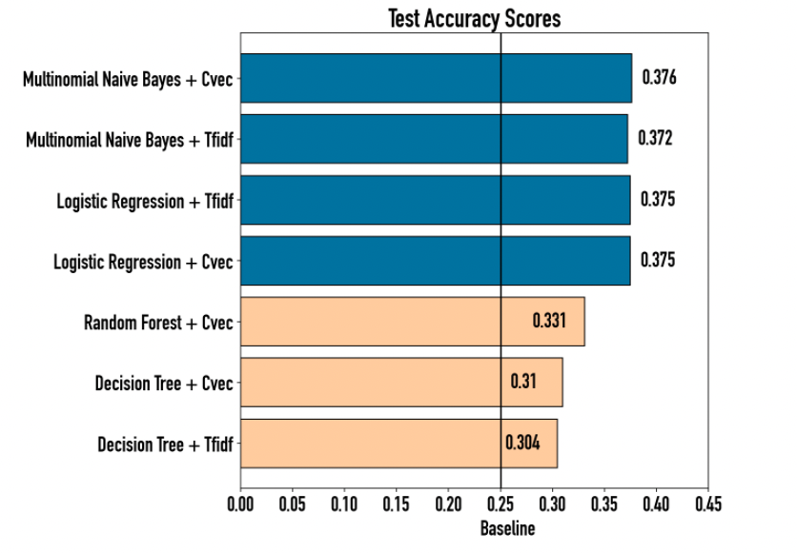
Simple Model performance
Presentation Stardate 4763.44

Slide 15
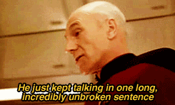
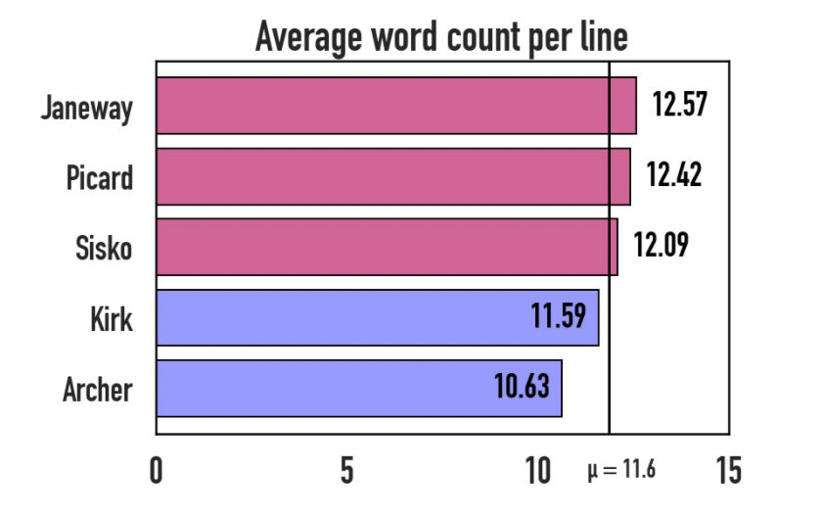
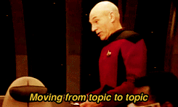
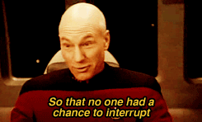
More Feature Engineering
Presentation Stardate 4763.44
Notes:
only looking at lines > 5 words!
Dr. Vassbinder gave an hour-long dissertation on the ionization effect of warp nacelles, before he realized that the topic was supposed to be - psychology!

Slide 16
More Feature Engineering
Analysing parts of speech:
use part-of-speech tagging
WP: wh-pronoun
VBP: verb (non-3rd-person singular present)
PRP: personal pronoun
VB: verb, base form
NNP: proper noun (singular)
Presentation Stardate 4763.44
Notes:
Wh-pronoun, verb (non-3rd-person singular present), personal pronoun, verb (base form), comma, proper noun (singular), period

Slide 17

More Feature Engineering
Word embeddings:
Presentation Stardate 4763.44
Notes:
Wh-pronoun, verb (non-3rd-person singular present), personal pronoun, verb (base form), comma, proper noun (singular), period

Slide 18
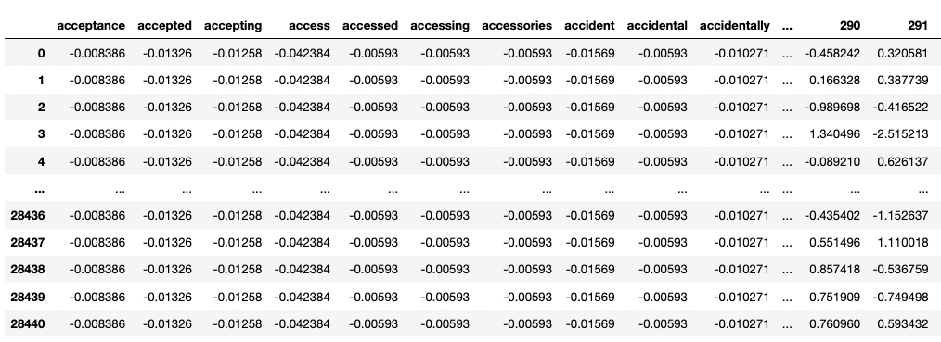
What the model sees
Train Set:
Test Set:
Presentation Stardate 4763.44
Notes:
Wh-pronoun, verb (non-3rd-person singular present), personal pronoun, verb (base form), comma, proper noun (singular), period

Slide 19
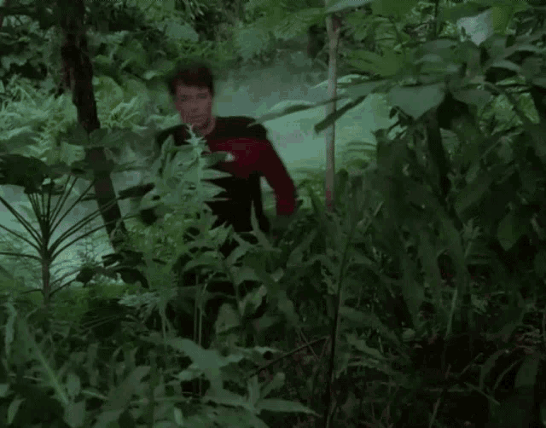
The Model
Presentation Stardate 4763.44

Slide 20
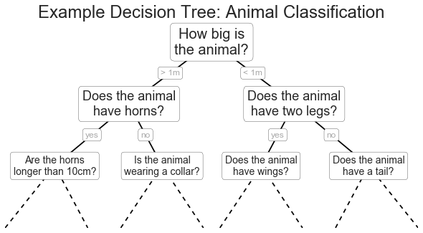
A Decision Tree
Decision Tree: Will this outfit look good?
f
scarf?
length of
scarf?
red pants?
purple hat?
…
…
…
…
Depth: 3
Presentation Stardate 4763.44
Notes:
Explain why infinite depth is not the best thing! -> overfitting

Slide 21
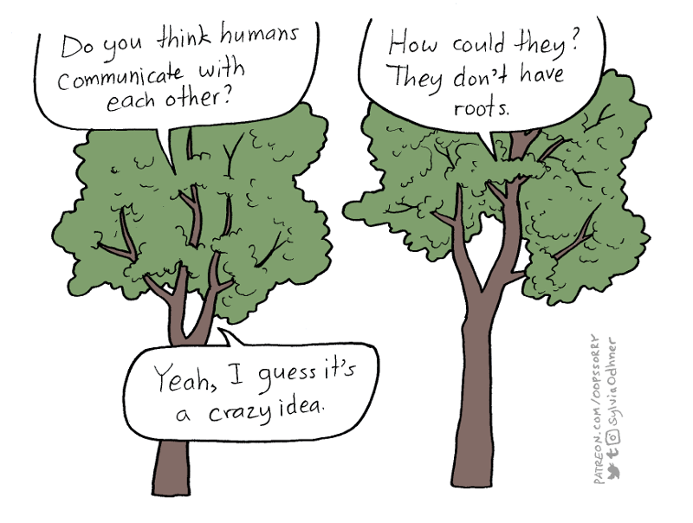

Random Forest
Number of trees per forest: 7
Presentation Stardate 4763.44

Slide 22
Boosting
Number of sequential forests: 500
Trying to correct the error of the previous forest
Presentation Stardate 4763.44

Slide 23
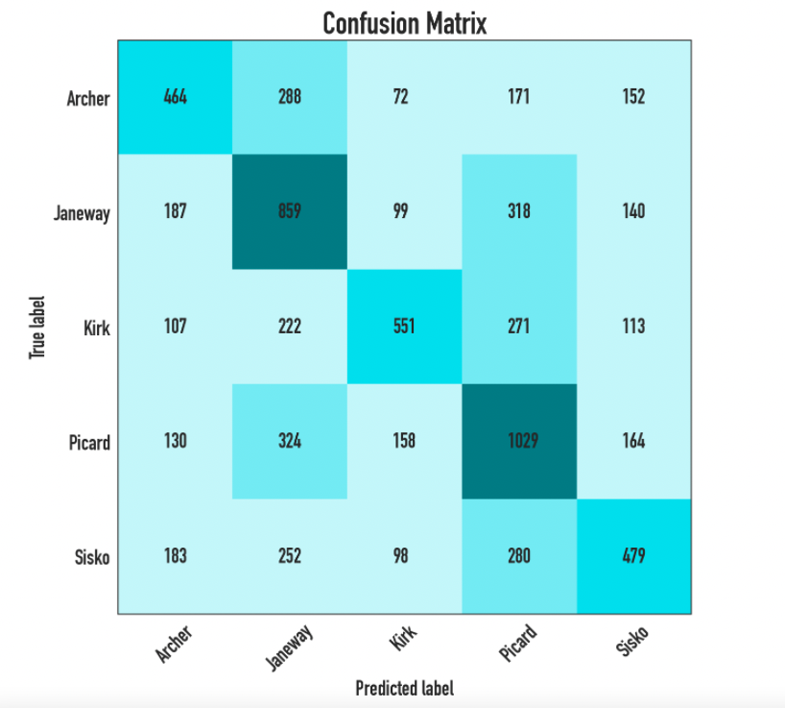
Evaluating the model
Accuracy:
( 464+859+551+1029+479 ) / 7111
= 0.4756
(Baseline: 0.25)
Presentation Stardate 4763.44
Notes:
# verb, determiner, noun (singular), preposition, adverb

Slide 24
What the model got right
Archer
Picard
Janeway
Presentation Stardate 4763.44

Slide 25
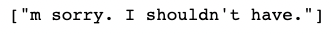
What the model got wrong
Correct: Picard (model guess: Kirk)
Correct: Sisko (model guess: Picard)
Correct: Archer (model guess: Janeway)
Presentation Stardate 4763.44

Slide 26
Live long and prosper!
Conclusion: you can train a model to be correct on guessing which of the 5 captains said a specific line almost half the time!
But is the model better than a human? You can try for yourself:
trek.jani.codes
Presentation Stardate 4763.44

Slide 27
Sources Visual Elements
Visuals:
Title: https://www.deviantart.com/futurephonic/art/LCARS-Computer-Network-47124917
LCARS Design: https://www.deviantart.com/retoucher07030/art/LCARS-Vector-Shapes-156730231
Picture Captains: https://screenrant.com/every-star-trek-captain-ranked/
Scotty Gif: https://imgur.com/gallery/KNEwW
Picture Troi: https://twitter.com/DeannaTroi_/photo
Picard pictures: https://tinyurl.com/37xjxhhu
Riker in the forest Gif: https://tenor.com/view/star-trek-riker-forest-lost-gif-15346557
Decision Tree example: https://jakevdp.github.io/PythonDataScienceHandbook/06.00-figure-code.html#Decision-Tree-Example
Forest example: https://ai-pool.com/a/s/random-forests-understanding
Presentation Stardate 4763.44

Slide 28
Additional Slides

Slide 29
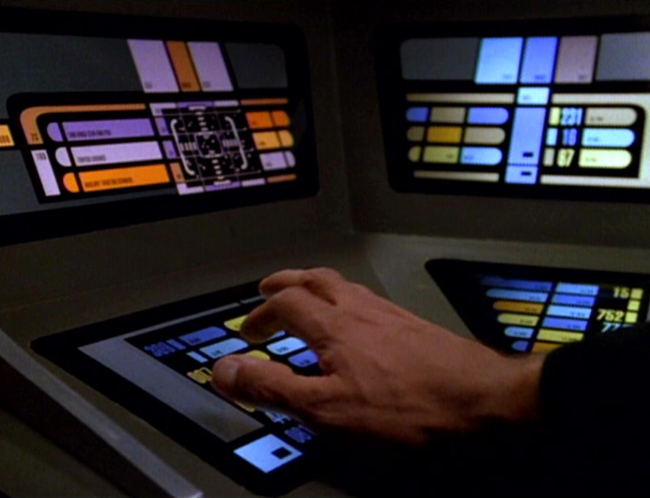
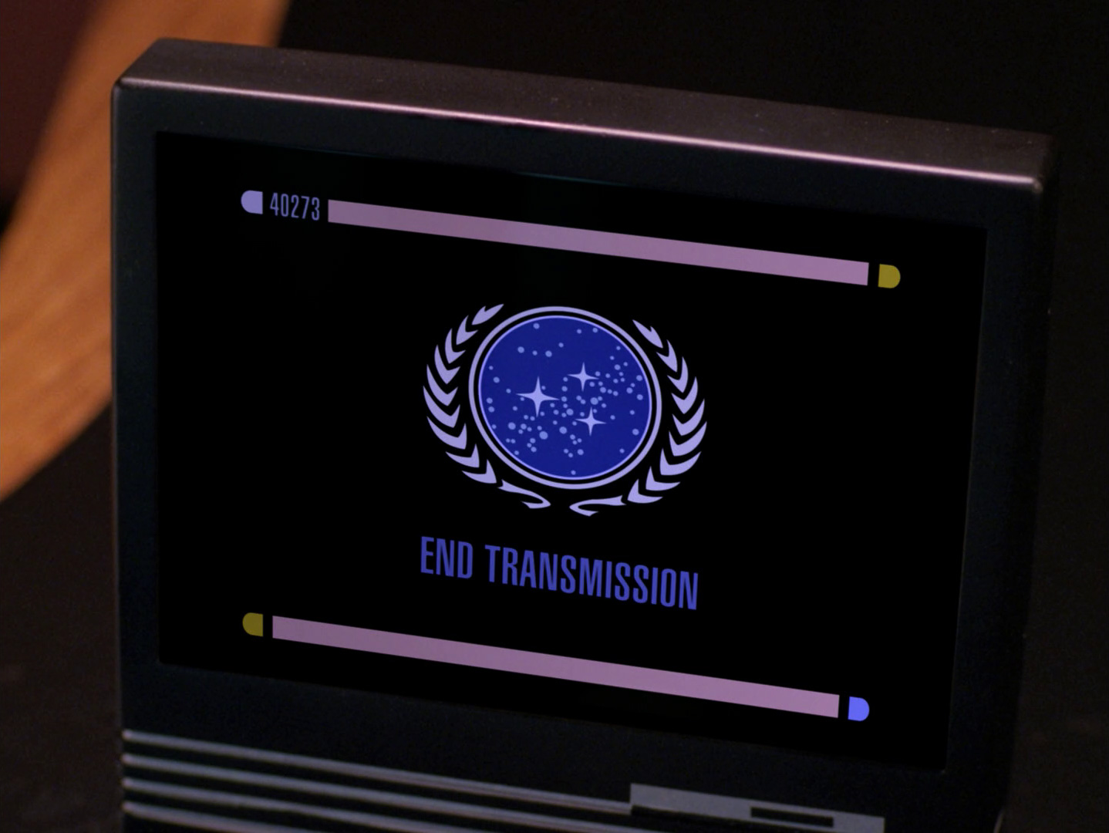
Title Size 27pt
Font: Antonio - Text size 14pt

Slide 30
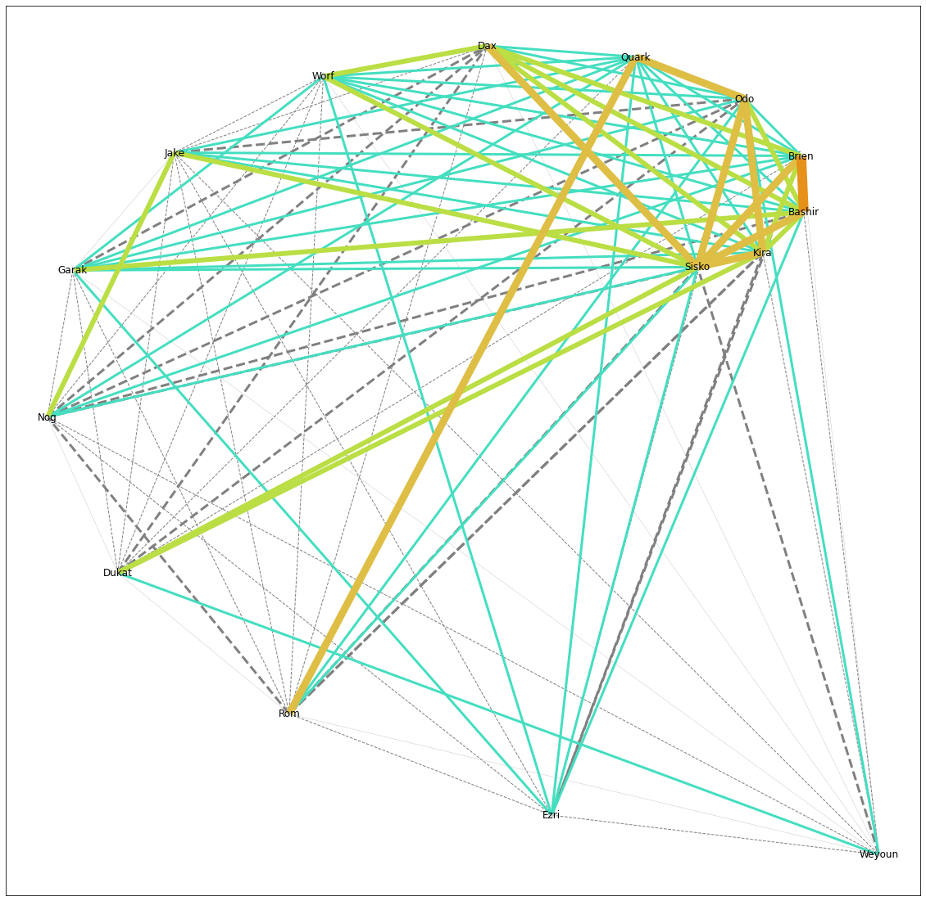
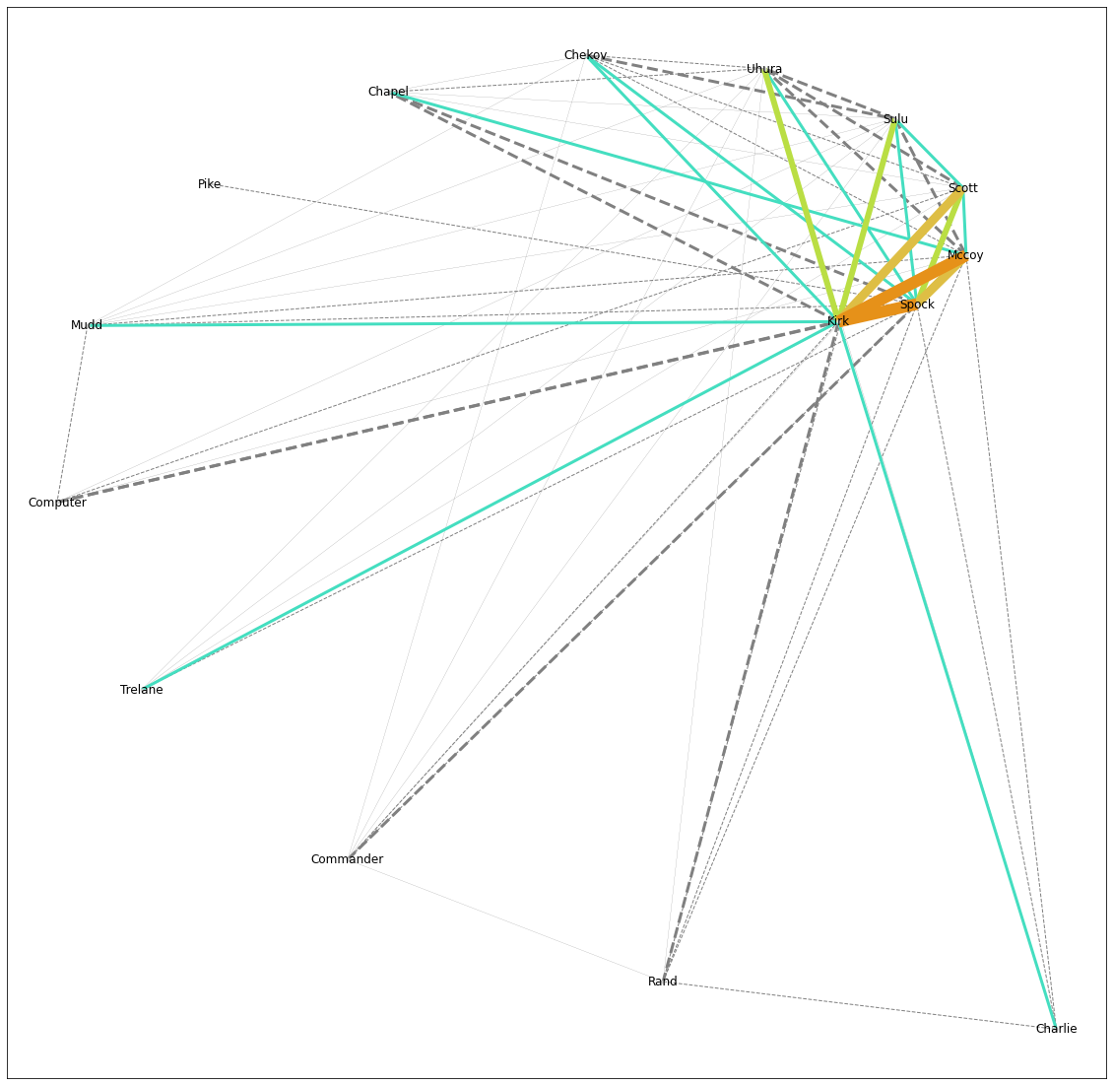
Network Graphs
Deep Space 9
The Original Series
Presentation Stardate 4763.44

Slide 31
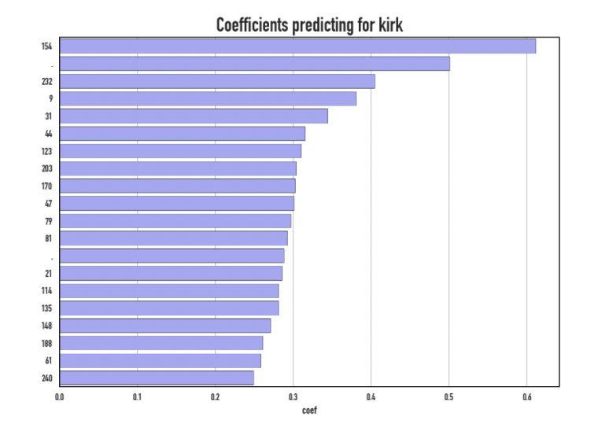
Coefs Engineered Features
Presentation Stardate 4763.44

Slide 32
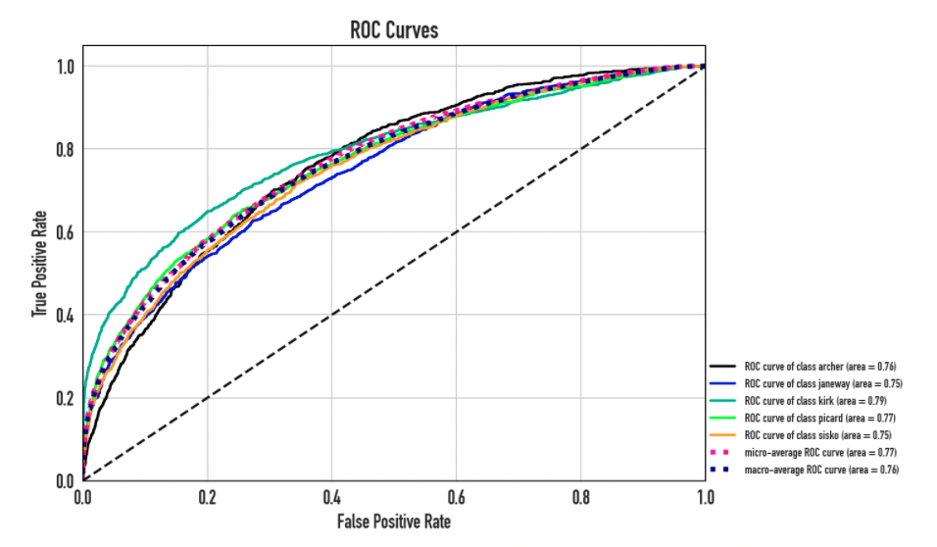
AUC Engineered Features
Presentation Stardate 4763.44

Slide 33
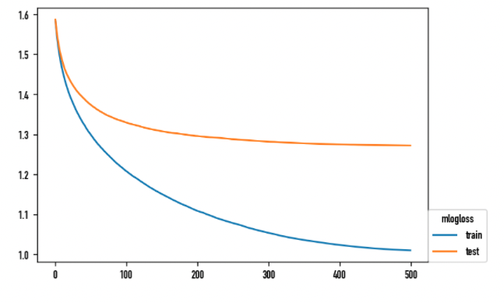
XGBoost 500 rounds
Presentation Stardate 4763.44

